Slide 1
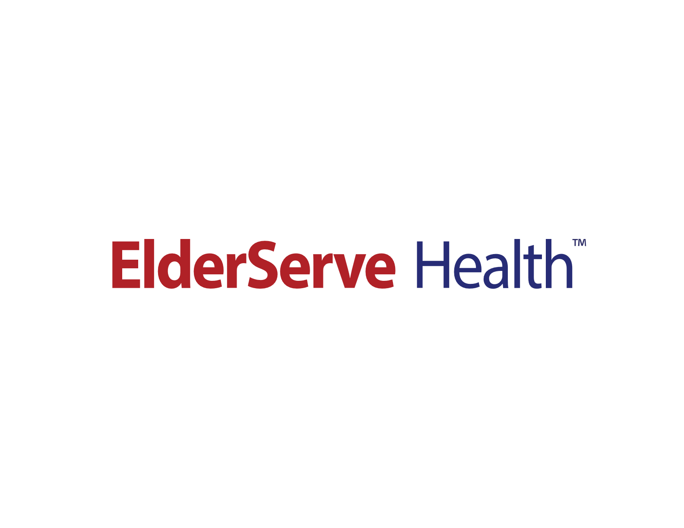
Special Needs Plan (SNP)
Model of Care (MOC)
Provider Training

Slide 2
CMS and NCQA Requirements
This MOC training manual is a quality improvement tool that ensures the unique needs of each beneficiary enrolled in a Special Needs Plan (SNP) are identified and addressed. The Affordable Care Act requires the National Committee for Quality Assurance (NCQA) to review and approve all SNP’s MOC, using standards and scoring criteria established by Centers for Medicare and Medicaid (CMS).
This manual was created to meet the CMS regulatory requirements for a SNP’s Model of Care. It also ensures that RiverSpring staff and providers who work with SNP members have the specialized training this unique population requires.

Slide 3
Training Objectives
At the end of this module you will be able to:
  Familiarize your self with 2 Medicare SNP Plans offered by ElderServe Health:
    ElderServe (HMO I-SNP)
    ElderServe (HMO D-SNP/MAP)
Describe the basic components of the MOC
Member Qualifications for our plans
Explain how ElderServe’s medical management staff coordinates care for members with special needs.
Describe the role of the provider in the implementation of the MOC program.
Describe the quality programs used to monitor the effectiveness of the program goals

Slide 4
What is a Special Needs Plan (SNP)
D-SNPs also known as Dual Eligible SNPs (D-SNPs) are designed to provide targeted care to individuals who have both Medicare and Medicaid benefits (also known as “dual eligibles”). ElderServe Health offers one HMO D-SNP/MAP plan.
I-SNPs also known as Institutional Special Needs Plans (I-SNPs) are designed to provide targeted care to residents residing in a long-term care facility or senior living community. ElderServe Health offers one HMO I-SNP plan.

Slide 5
SNP Target Population
ElderServe I-SNP
ElderServe D-SNP/MAP
Eligible for both Medicare and Medicaid
Reside in ElderServe service area
Eligible for Medicaid determined nursing home level of care at time of enrollment
Eligible for long-term services and supports
Require community-based long term care (CBLTC) services for more than 120 days
Effective 9/1/2025 must meet the Minimum Needs Requirement at enrollment and reassessment.
Eligible for Medicare
Reside in ElderServe service area
Reside in I-SNP nursing home for 90 days or longer at time of enrollment; or Reside in community, and requires an institutional level of care

Slide 6
Components of MOC
The MOC is comprised of four clinical and non-clinical elements:
• Description of the SNP population
• Care coordination
• SNP provider network
• Quality measurements & performance improvement

Slide 7
Model of Care Objectives
The key objectives of ElderServe’s evidence-based MOC include:
Evaluate and improve members’ access to plan services;
Ensure members’ access to safe medical, behavioral, and preventive health care;
Improve and monitor continuity and coordination of care through interdisciplinary care teams;
Review and evaluate status of care against regional and national benchmarks and requirements;
Improve member health outcomes
Ensure appropriate use of clinical practice guidelines;
Measure and address member satisfaction.
Measure health equity by addressing disparities within the population.
Monitor changes in population needs over time.

Slide 8
Care Coordination
ElderServe conducts Care Coordination to meet the target needs of our member by utilizing the following strategies:
Conducting a Health Risk Assessment (HRA) of the individual’s physical, psychosocial, and functional needs, using assessment tools approved by CMS and other appropriate regulatory agencies.
Developing an Individualized Care Plan (ICP) developed by an Interdisciplinary Care Team (ICT) and, in consultation with the member, identifying goals and objectives as well as specific services and benefits to be provided.
Coordinating an ICT that manages the member’s care and meets regularly to manage the medical, cognitive, psychosocial, and functional needs of the member.

Slide 9
Health Risk Assessment (HRA)
Regulations 42 CFR § 422.101(f)(1)(i); 42 CFR § 422.152(g)(2)(iv) require that all SNPs conduct an HRA for every SNP enrollee
HRA is an objective tool used to collect information on a beneficiary's health status, health risk factors, social determinants of health, and functions of daily living. These evaluations are used to assess the overall health of beneficiaries, document diagnoses, and identify gaps in care.
ElderServe uses forms such as the NYS UAS tool, and standardized, generally accepted forms such as the Adult Depression Scale form. Each form is developed under the direction of the responsible director and SVP with input and review from the Medical Director and staff members.
The HRA includes information about the member’s race, ethnicity and language (spoken and written preferences) so that ElderServe staff can assist the member and the care team in planning a culturally tailored plan of care.

Slide 10
Interdisciplinary Care Team (ICT)
Regulations 42CFR § 422.101(f)(1)(iii); 422.152(g)(2)(iv) require all SNPs to use an ICT in the management of care for each individual enrolled in a SNP.
The NCM is the leader of the ICT. The NCM confers with the member’s PCP, the member, key physicians, in the care of the member, and with others relevant to the situation. The NCM uses the health risk assessment tools (HRA) to identify member needs and develop the Individualized Care Plan (ICP). The HRA and ICP help determine when additional ICT members are needed to meet the member’s needs.
Individuals residing in institutions are designated NCMs with expertise in SNF/ NF admissions (custodial and skilled).
The ICT has ongoing responsibility for ensuring that the member’s health risks are identified on an ongoing basis and that the member’s healthcare needs and risks are appropriately addressed by the plan of care.

Slide 11
Individualized Care Plan (ICP)
Regulations 42 CFR §422.101(f)(ii); 42 CFR §422.152(g)(2)(iv), require SNPs to develop and implement an ICP for each individual enrolled in the SNP.
The plan of care is a comprehensive member-centric plan that documents problems, goals and interventions to address the integrated physical, behavioral and psychosocial needs of the member. The plan of care is based on member needs, goals and preferences. It includes member information related to history, current status, home situation, any behavioral health or psychosocial factors, diet or nutritional needs, medications, family and caregiver involvement, health care providers, health wishes, and advance directive status, member and caregiver preferences and needs, etc.
The ICP is developed by the ICT by using input from the assessment, member, caregivers, NCM, PCP and others. It may include identification of gaps and referrals to needed services, visit types, frequencies, equipment, supplies, hours of aide services and transportation needs, among other services.

Slide 12
Nurse Care Managers
Responsibilities include developing, documenting, coordinating, implementing and managing the members’ care plans. They are responsible for monitoring services for quality, appropriate utilization and efficacy, and coordinating transitions across the continuum of settings.
They are responsible for ensuring communication across the ICT, coordination of materials and including the member in ICT discussions. Other responsibilities include assuring that referrals to medical specialists result in timely appointments; assisting members to develop wellness strategies and self- management skills to effectively access and use services; and monitoring for gaps in care.

Slide 13
Role of the Provider
An ElderServe Network Provider is required to complete ElderServe Model of Care Training.
Providers are notified about the importance of completing the SNP model of care training.
The SNP Provider Network is a network of healthcare providers who are contracted with ElderServe to provide health care services to SNP beneficiaries.
Our Model of Care offers an opportunity to work together for the benefit of ElderServe members by:
Enhanced Communication
Focusing on each member’s special needs
Being an integral part of the member’s ICT
Supporting the member’s ICP

Slide 14
Measurable Goals and Outcomes
In accordance with 42 CFR §422.152(g),
ElderServe conducts a quality improvement program that measures the effectiveness of its MOC
ElderServe has adopted the Plan Do Study Act (PDSA) quality improvement methodology from the Institute of Healthcare Improvement as the systematic approach across all departments to ensure continuous quality improvement in the Plan’s clinical and service performance and operational functions and efficiencies, including those related to the MOC.

Slide 15
Quality Measures
ElderServe carries out multiple processes to continually evaluate the quality performance of its MOC. These initiatives are analyzed to evaluate how the overall quality program/MOC accommodates the SNP members’ unique healthcare needs
and impacts outcomes. Here are a few examples:
Chronic Care Improvement Program (CCIP)
Quality Improvement Project (QIP)
HEDIS
Health Outcomes Surveys (HOS)
Consumer Assessment of Healthcare Providers and Systems Survey (CAHPS)

Slide 16
Measurable Goals and Outcomes
ElderServe carries out multiple processes to continually evaluate the quality performance of its MOC. Below are just a few examples:
Chronic Care Improvement Program (CCIP): ElderServe conducts and annually reports on a CCIP that targets members with multiple or sufficiently severe chronic conditions.
Quality Improvement Project (QIP): ElderServe conducts and annually reports on QIP initiatives focused on one or more clinical and/or non-clinical areas with the aim of improving health outcomes and beneficiary satisfaction.
HEDIS® and Health Outcomes Surveys (HOS)

